Slide 1

Electric Vehicle Calculation and Modeling using MATLAB
Mentor - Neelu Nagpal Ma’am
Team - Ayush Agarwal (43414804918) Abhimanyu Bhambhu (43314804918)
Department of Electrical and Electronics Engineering
Maharaja Agrasen Institute of Technology, Delhi
2021

Slide 2
Table of Contents
Contents | Pages
Introduction | 3-5
Literature Survey | 6
Components | 7
Block Diagram | 8-9
Working | 10
References | 11

Slide 3
Introduction
An electric vehicle (EV) is a vehicle that uses one or more electric motors for propulsion.
So, what I want to do the calculation and modeling of the electric vehicle components like battery and motor dynamic stuffs.
MATLAB (an abbreviation of "MATrix LABoratory") is a proprietary multi-paradigm programming language and numeric computing environment developed by MathWorks.
Modeling and simulation in Matlab-Simulink has shown to be of great value in investigating energy flow, performance and efficiency of the EV drive system.
All the modeling and simulation of vehicle calculation done in SIMULINK for the easy visualisation.
Modeling and simulation is very important to the automotive designers in order to find best energy control strategy, exact components size, and to minimize the use of energy, because prototyping and testing are expensive and complex operations.

Slide 4
In order to find the best voltage, current, capacity, battery charge state and the exact size of the part, and minimise the for automotive designers, the use of electricity, modelling and simulation are very important.
The torque and speed conditions during motoring and regeneration were used to determine the energy flow, performance and efficiency of the drive. This study forms the foundation for further research and developments.
The Battery performance is mainly dependent upon the working ambient temperature. It is easy to calculate this by simulation in different temperature.
BEV and its components were simulated in this study in to examine the flow, output and efficiency of energy. By using MATLAB-Simulink, good results for battery voltage, current, power, and state of charge were shown. There are still a lot of possibilities ahead to build a better BEV model that will be the basis for future studies.
Below show different type of models of battery that are possible by different simulation and we had to choose which one can be differentiate by these simulations.

Slide 5
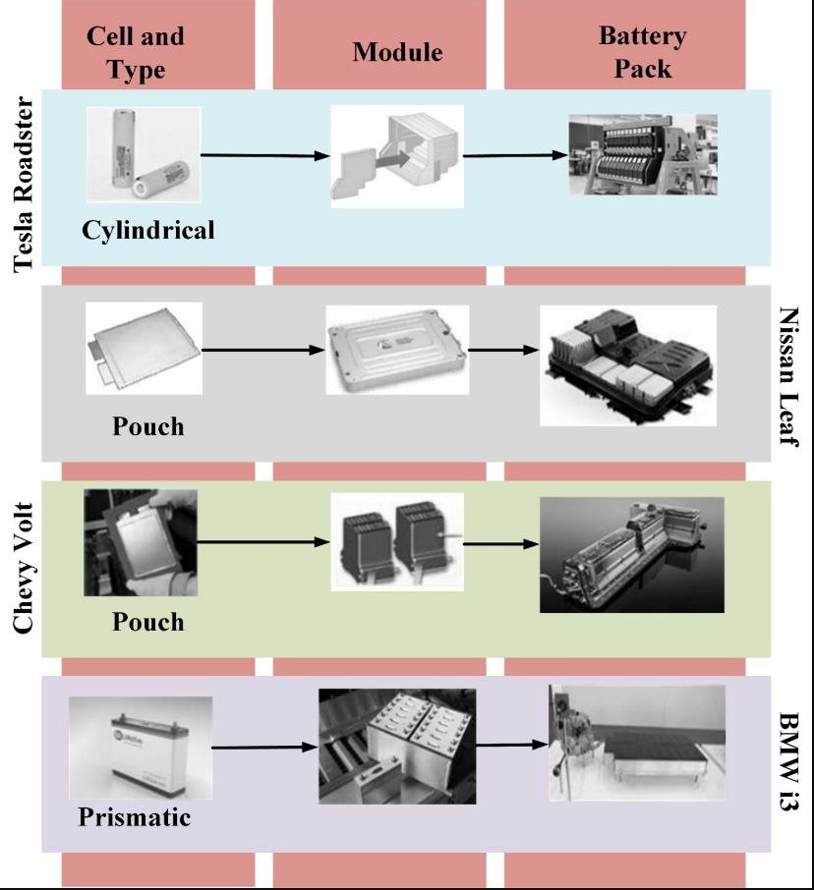

Slide 6
Literature Review
E. Schaltz, designed and modeled an electric vehicle. This vehicle consumes 148.3 Wh/km of energy. Also explains that a large part of the energy loss is caused by the auxiliary loads, the lighting system, the security systems, the comfort systems and the battery.
Since range anxiety is prominent especially among indian customers, work should be done to create more versatile & reliable batteries, better infrastructure for charging etc. and this is possible by many simulation which is possible cost effectively by software.
Numerous simulation and modelling package have been developed to study the operation of electric and hybrid power trains, such as CarSim from AeroVironment Inc., SIMPLEV from DOE’s Idaho National Laboratory, MARVEL (Argonne National Laboratory), V-Elph (Texas A&M University) and ADVISOR (DOE’s National Renewable Energy Laboratory, US). Butler, Ehsani, & Kamath (1999) in his study presented four vehicle drive trains; an EV, parallel hybrid EV (HEV), series HEV, and conventional ICE vehicle modeling, simulation, and analysis package using Matlab Simulink to investigate fuel economy, efficiency and emissions.

Slide 7
Components
MATLAB - Since the project is simulation based, we will be using MATLAB/Simulink.
Electric Propulsion System - Electric Motor, Inverter, Electronic Converter, DC-DC and DC-AC Converter
Energy Source - Battery , ICE, Ultra Capacitor, Fuel Cell etc. (Based on type of EV)
Energy Management System, Charging/Refueling Unit
Auxiliary Systems - Thermal Management System, Console System

Slide 8
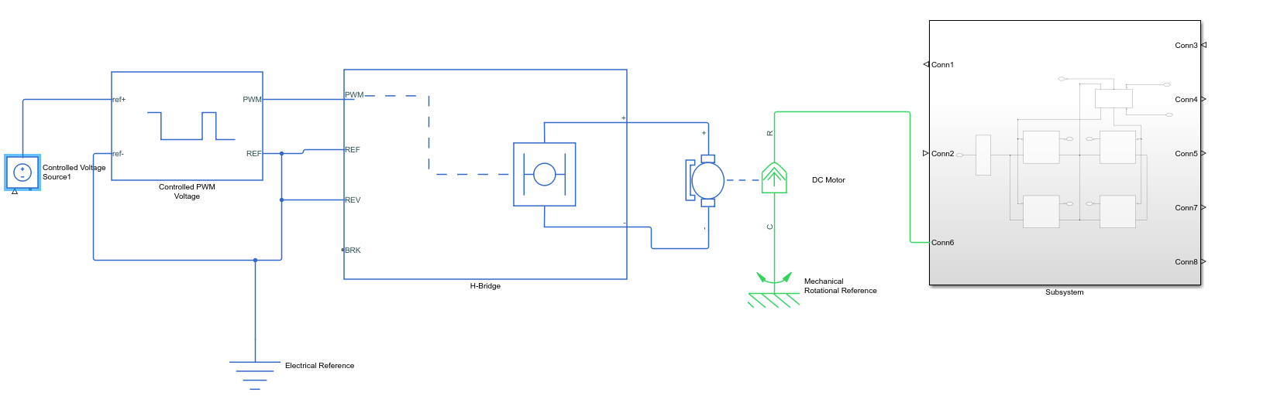
BLOCK DIAGRAM

Slide 9
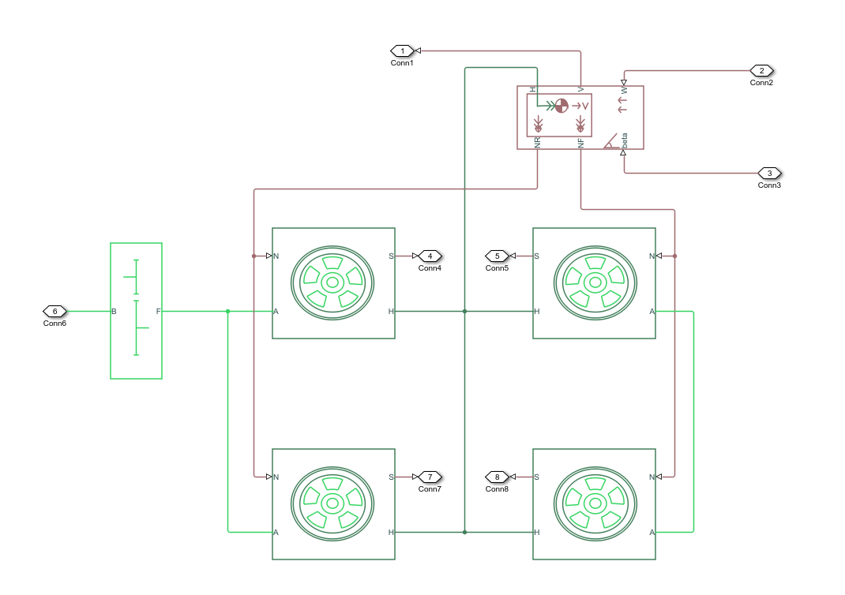

Slide 10
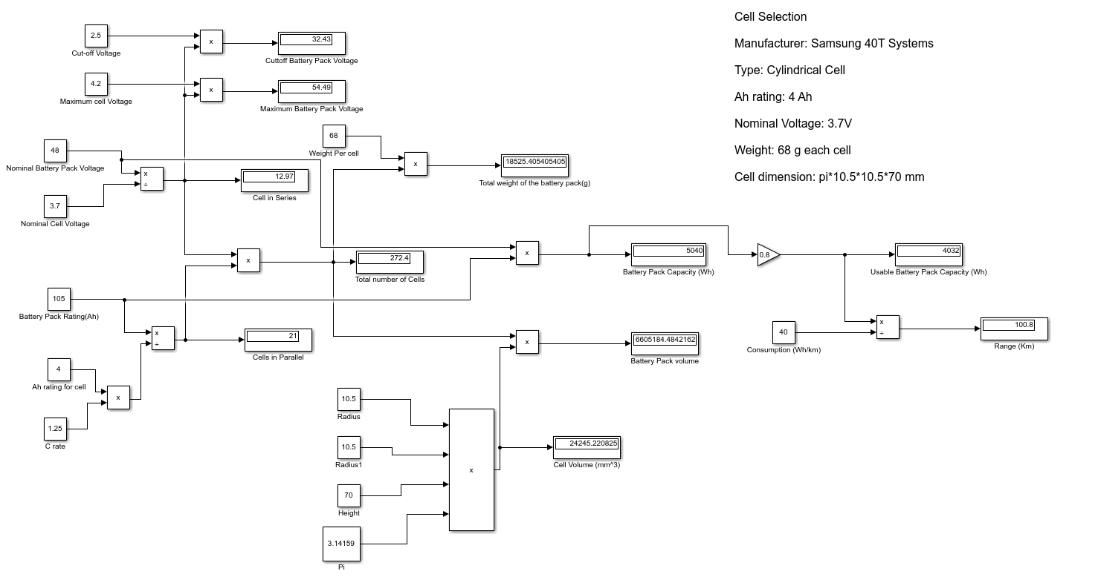
Working

Slide 11
References
J. Y. Yong, V. K. Ramachandaramurthy, K. M. Tan, and N.Mithulananthan, “A review on the state-of-the-art technologies of electric vehicle, its impacts and prospects,” Renew. Sustain. Energy Rev., vol. 49, pp. 365– 385, 2015.
Meradji, M., Cecati, C., Wang, G., &Xu, D. (2016). Dynamic modeling and optimal control for hybrid electric vehicle drive train. In 2016 IEEE International Conference on Industrial Technology (ICIT) (pp.1424– 1429).IEEE.https://doi.org/10.1109/ICIT.2016.7474967.
Butler, K. L., Ehsani, M., & Kamath, P. (1999). A Matlab-based Modeling and Simulation Package for Electric and Hybrid Electric Vehicle Design. IEEE Transactions on Vehicular Technology, 48(6), 1770-1778. doi: 10.1109/25.806769
https://www.researchgate.net/publication/260299 341_Design_and_Development_of_Small_Electric _Vehicle_using_MATLABSimulink.
Xue, X.D., Cheng, K.W.E. and Cheung, N.C., 2008, December. Selection of electric motor drives for electric vehicles. In Power Engineering Conference, 2008. AUPEC'08. Australasian Universities (pp. 1-6). IEEE.

Slide 12
THANK YOU

